Slide 1
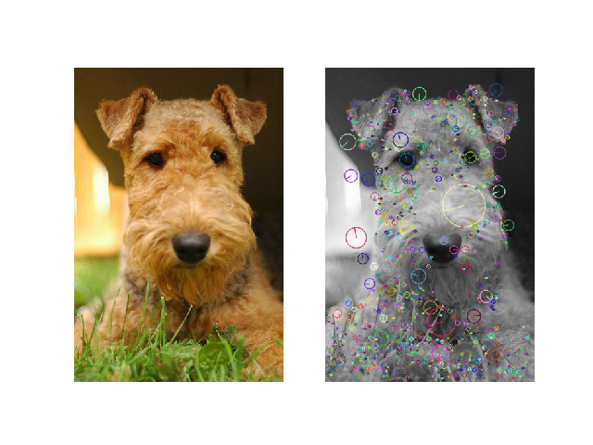
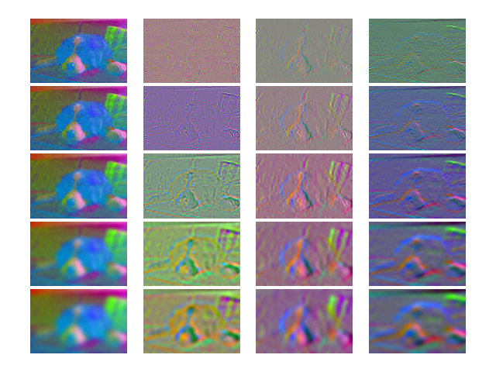
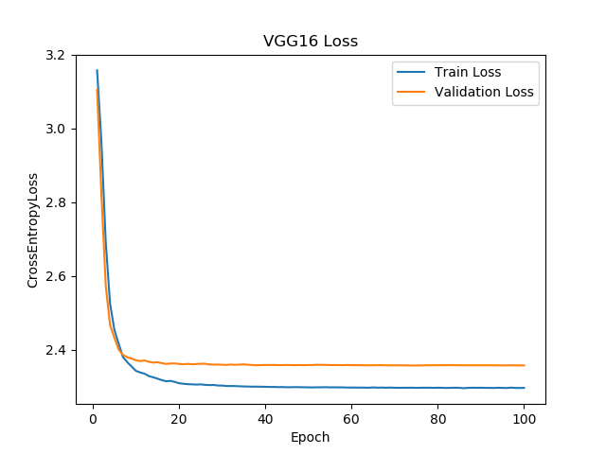
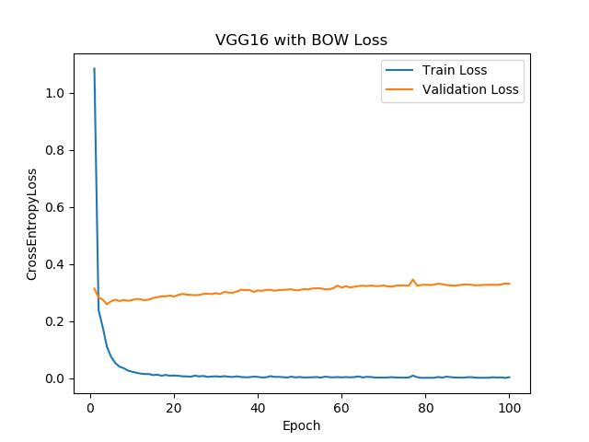
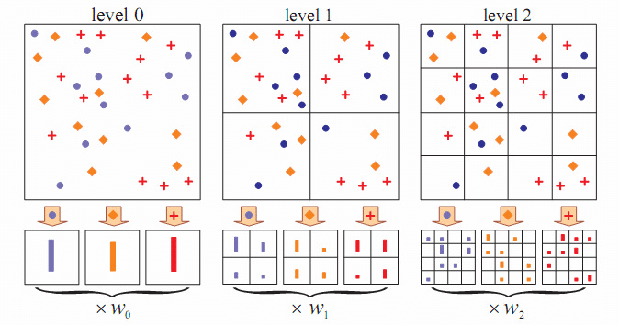
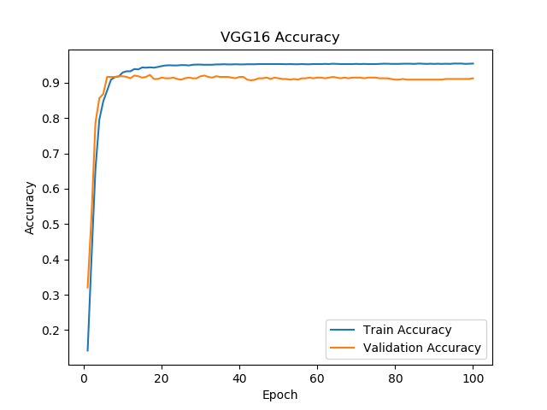
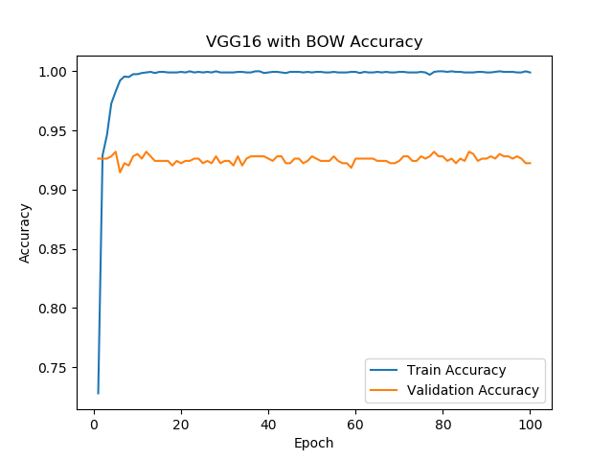
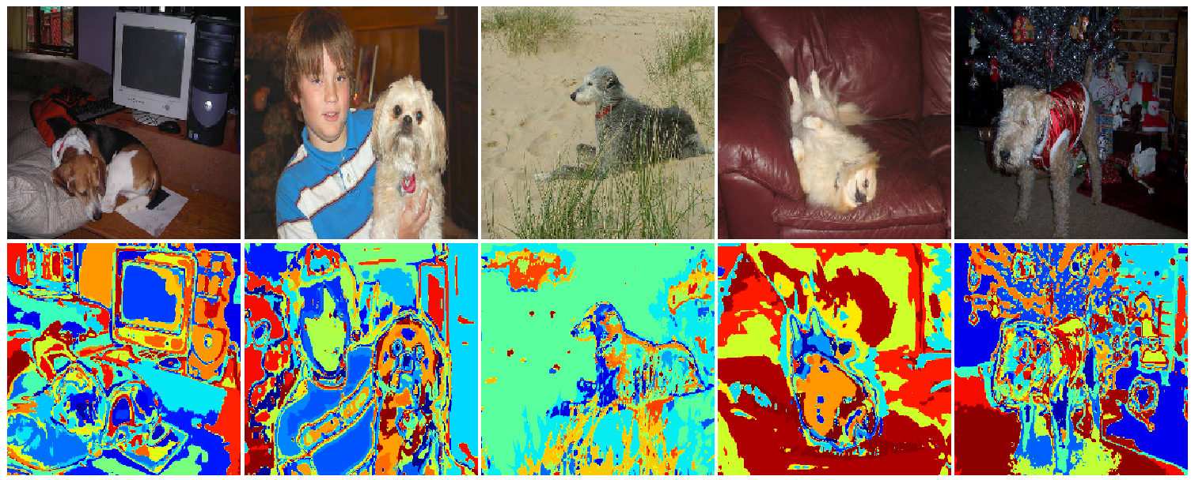
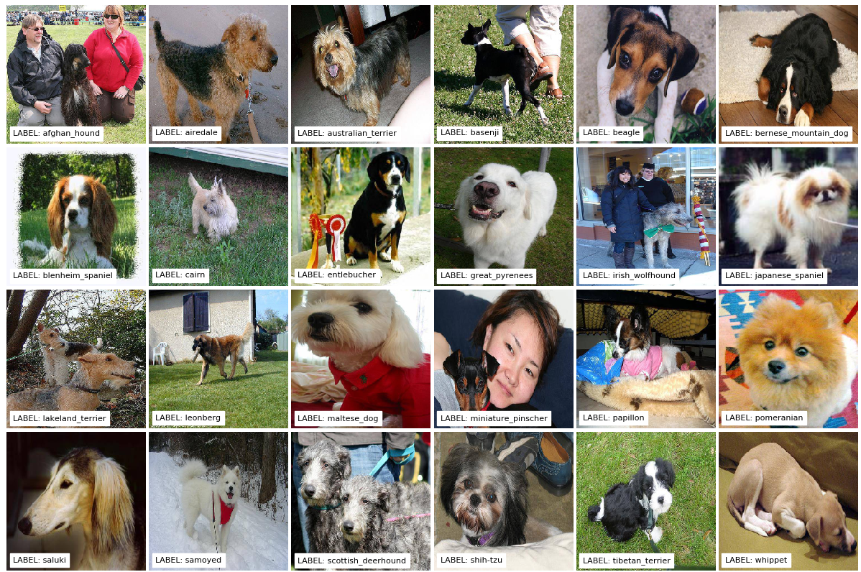
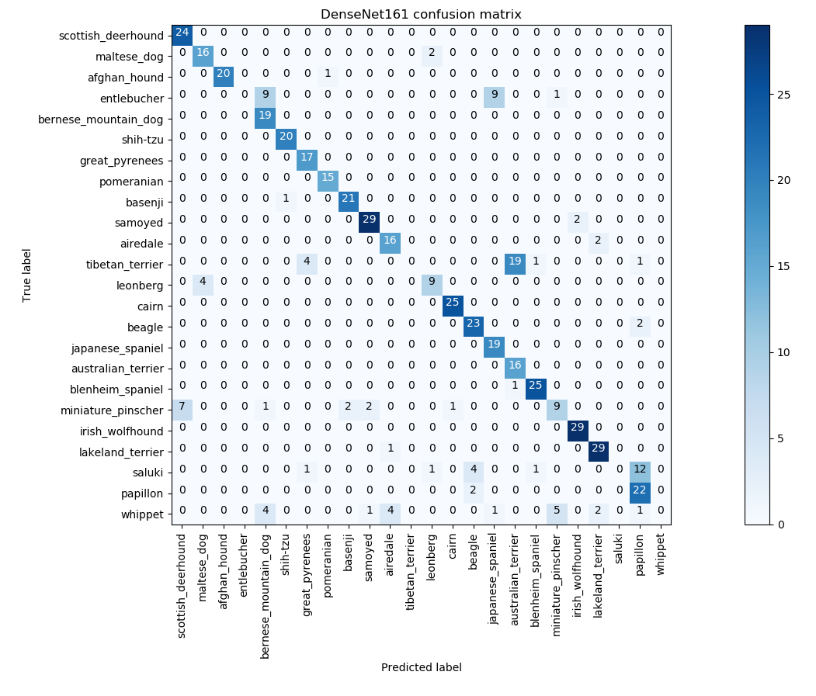
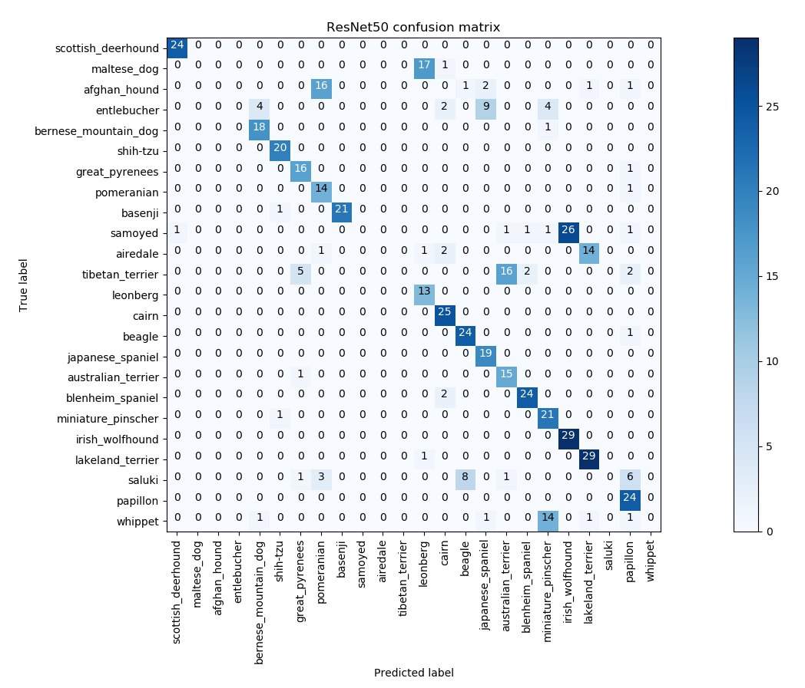
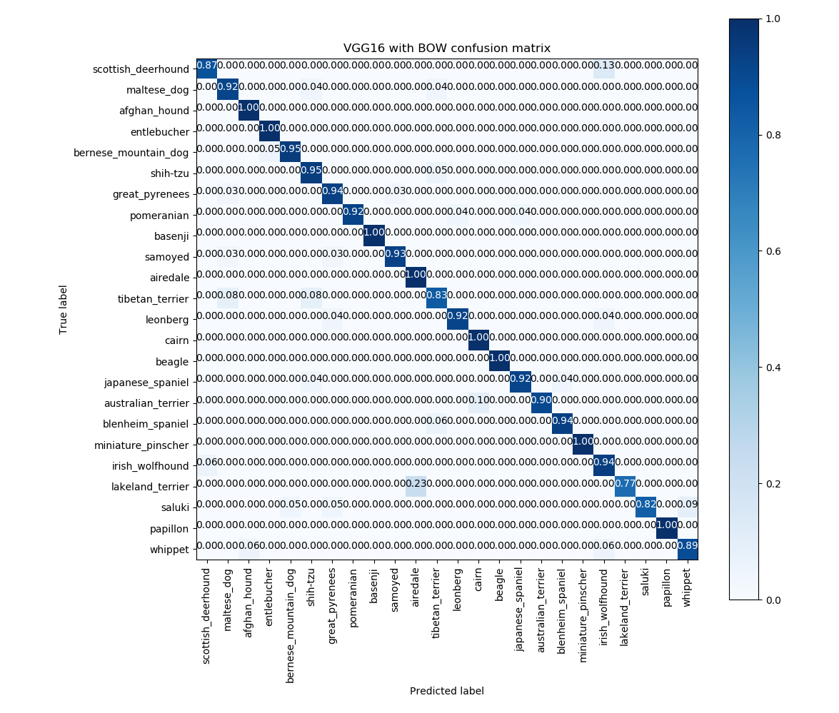
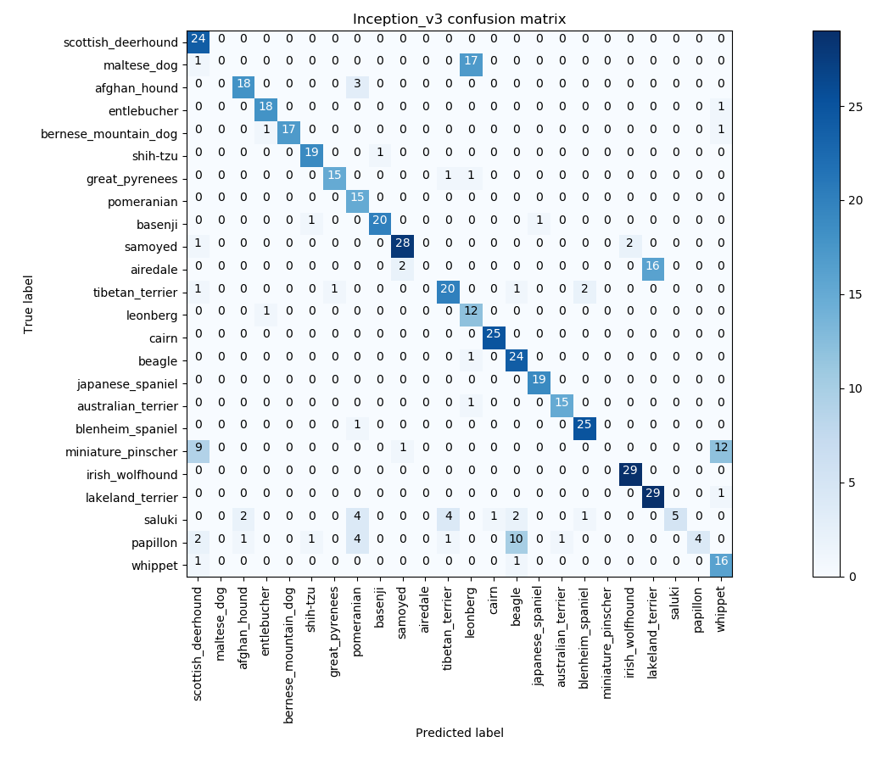
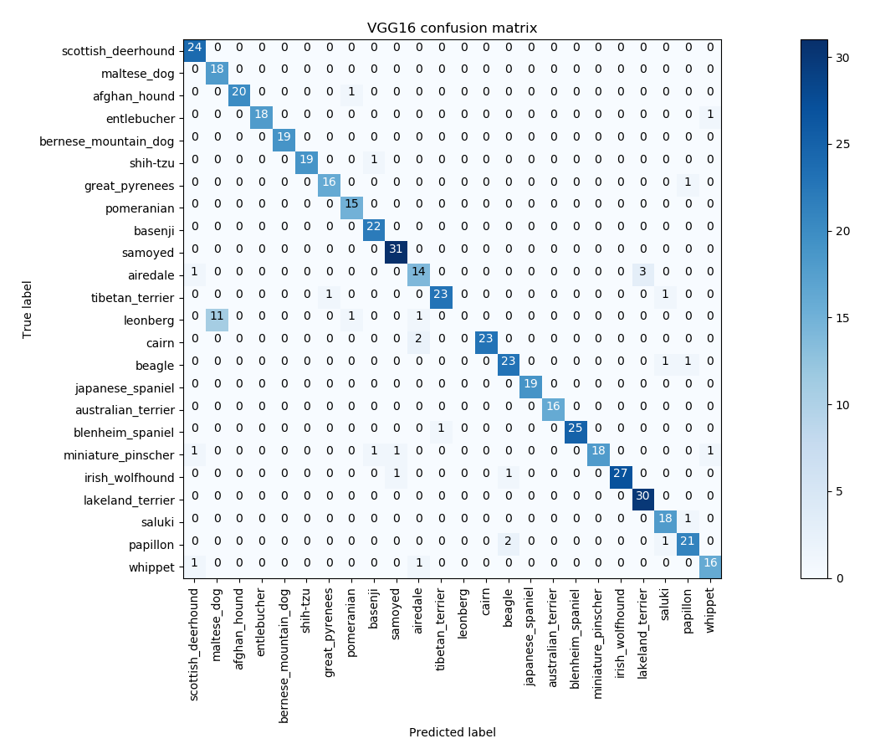
Dog Breed Identification with Convolutional Neural Network and Scale Invariant Bag of Words Feature Maps
Tianai Kong, Han Zhang, Tianning Zhang
Biomedical Engineering, Carnegie Mellon University
Abstract/overview
PROPOSED METHODS/DESCRIPTION
RESULTS
In this project, we intend to identify the breed of a dog in an image via Convolutional Neural Network (CNN) and Spatial Pyramid Matching (SPM). The overall accuracy of classification of 24 different dogs breeds on the validation dataset achieves ~92%.
Training Loss and Accuracy
Dense Filter
SIFT Keypoints
Introduction/motivation
Spatial Pyramid Matching
Dogs have been selectively bred for quite a long time. So far, there are hundreds of different dog breeds, and the total number is continuously increasing.
In this project, we intend to determine the breed of a dog in an image through pattern recognition methods. The dataset we are using is pulled from Kaggle, and we selected the top 24 breeds as shown below for classification.
BoW Features
Input Image
Confusion Matrices of common CNN architectures and proposed model
Conv Block #1
Conv Layer
Conv Block #4
Conv Layer
Conv Layer
Conv Layer
MaxPooling
Conv Layer
MaxPooling
Input Image
Conv Block #2
Conv Layer
Conv Block #5
Conv Layer
Bag of Words extraction
SIFT Keypoint
Conv Layer
Conv Layer
Dense Filter
MaxPooling
Conv Layer
Spatial Pyramid Matching
Example pictures from the dataset
Conv Block #3
Conv Layer
MaxPooling
BoW Features
This problem are faced with 3 challenges:
Large scale of inner-class variations
varied poses, occlusion and hair colors of the same class
Limited inter-class variations
genetically related, variations may not be distinctive
Background variations
human figures, scene and lighting
Conv Layer
FC Block
Flatten
Conv Layer
Dense
Confusion Matrices of 4 baseline models
MaxPooling
Dense
Test Confusion Matrix
Softmax
CONCLUSIONS
References
The Spatial Pyramid Matching features of the images improves the accuracy of VGG16 network. Overall accuracy of classification of 24 different dogs breeds on the validation dataset achieves ~92%. Though there appears to be overfitting of the model on the training set. The Bag of Words representation of images increase the bank of features.
Both models converges very fast at the beginning and was stuck at some point during training. The misclassified images showed great similarity and were hard to discriminate even by experienced people.
Method and apparatus for identifying scale invariant features in an image and use of same for locating an object in an image", David Lowe's patent for the SIFT algorithm, March 23, 2004
Alex Krizhevsky, Ilya Sutskever, Geoffrey E. Hinton. ImageNet Classification with Deep Convolutional Neural Networks, 2012.
He, Kaiming et al. “Deep Residual Learning for Image Recognition.” 2016 IEEE Conference on Computer Vision and Pattern Recognition (CVPR) (2016): 770-778.
Simonyan, K. & Zisserman, A. (2014). Very Deep Convolutional Networks for Large-Scale Image Recognition. CoRR, abs/1409.1556.
Huang, G., Liu, Z., Maaten, L.V., & Weinberger, K.Q. (2017). Densely Connected Convolutional Networks. 2017 IEEE Conference on Computer Vision and Pattern Recognition (CVPR), 2261-2269.
SIFT (Scale-invariant feature transform) detects Keypoints in images.
Use SIFT keypoints to build BoW (Bag of Words) representation of a image.
Spatial Pyramid Matching (SPM) captures spatial correspondences to the Bag of Word dictionary.
Use Neural Network to learn patterns from SPM features.
Notes:
1
https://guides.library.cmu.edu/scienceposters/design
ResNet50, VGG16, Inception v3 and DenseNet

